Slide 1
Data Analysis capstone project
Adrian Valentín

Slide 2
Introduction
Business task: the business task is to design a marketing campaign aimed at those customers that are more likely to change from casual ridership plans to member plans.
Objective of these analysis: Find patterns on casual trips that differ from member trips, so the company can decide how to guide the marketing campaign.

Slide 3
Introduction
Key Stakeholders:
Managers which are interested in improving the company’s profit.
Clients, which are the target of the campaign and they could benefit of adquiring a more convenient product.
Society. As current customers are convinced to use more the service, this could result in a decrease of the usage of contaminating transport means such as cars and therefore reducing traffic, which is an important concern in most cities.

Slide 4
Data preparation.
Data located in AWS bucket.
A local copy is downloaded
A copy on Google Cloud is loaded for SQL manipulation with bigquery.

Slide 5
Data ROCCC
Reliability: The data is reliable as it represents all the rides and it is supported by the city of Chicago.
Originality: Data is original as it contains raw records of bike trips.
Comprehensiveness: A limitation is that there is no personal information about clients.
Current: This data is from the past 12 months, not including the current month so the newest records are from less than 1 month ago. For this specific analysis the data is current.
Cited: This data is cited by google to be used in it’s capstone project. It is cited by many other students.

Slide 6
Let’s dig in Data.
5755694 Trips are recorder in this dataset.
1345256 (23%) of them have missing values.
Missing values are on station names and/or coordinates.
All lines with missing information are cleaned up.
By membership the numbers are:
membership_type | total_members
member | 3402661 (59%)
casual | 2353033 (41%)

Slide 7
Now we ask which is the most frequent day of usage.
It looks that for casual members use their bikes for leisure (on weekends) and members use the bikes for work.
Membership_type | Count | Most used day | Num Trips
casual | 2353033 | SAturday | 485281
member | 3402661 | thursday | 532670

Slide 8
So now I will look at the time they spent per trip.
It looks that members usually make shorter trips than casual members. Casual trips last more that twice tan membership trips.

Slide 9
Deep Analysis.
In order to investigate further the behaviour of casual vs members I will focus in the 10 stations with more casual riders.
 | start_station_name | num_trips_casual
1 | Streeter Dr & Grand Ave | 58383
2 | DuSable Lake Shore Dr & Monroe St | 32598
3 | Millennium Park | 25990
4 | Michigan Ave & Oak St | 25327
5 | DuSable Lake Shore Dr & North Blvd | 23792
6 | Shedd Aquarium | 20451
7 | Theater on the Lake | 18574
8 | Wells St & Concord Ln | 16392
9 | Dusable Harbor | 14270
10 | Clark St & Armitage Ave | 13964

Slide 10
Deep Analysis.
How does customers behave in these stations?
In the following graph we can see how they behave casual and members for each station and by day of the week.

Slide 11
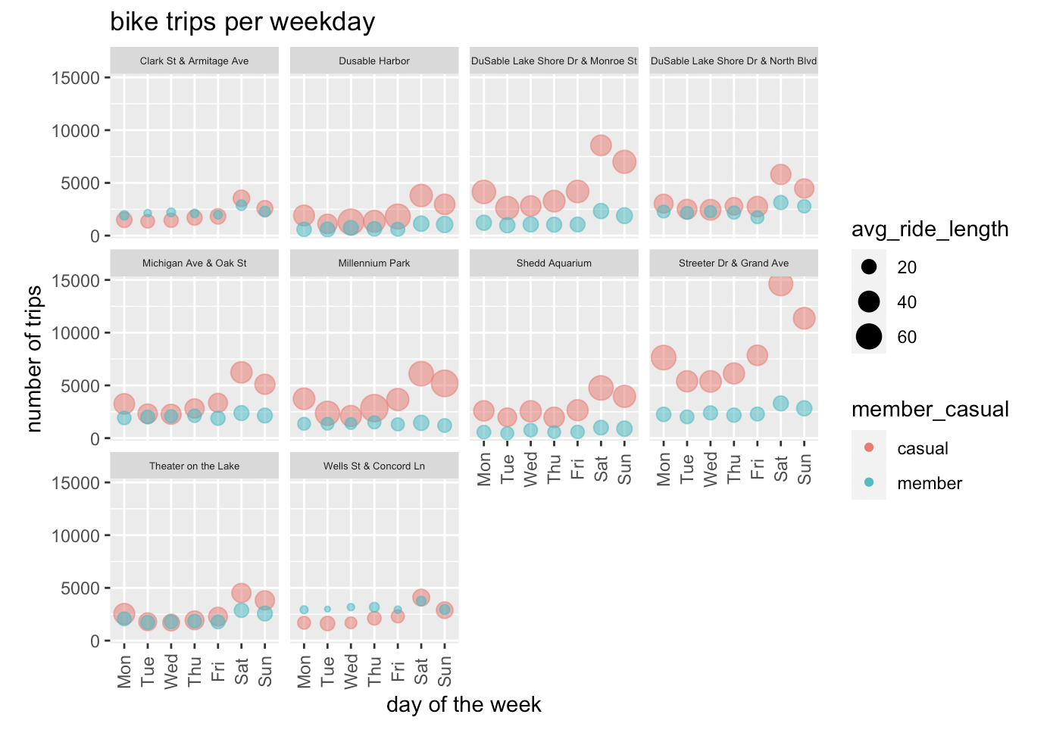
Casual members concéntrate their actity on weekends for all stations.
Members tend to tend a more even distribution of the bike usage.
Average ride length is quite independent from the day of the week.

Slide 12
Insights
From this analysis we can get the following insights.
Member trips are much shorter than casual trips. This could be beacuse it is inconvenient for the customer to buy a one day or one ride pass for a short trip as the cost is the same regardless the length of the trip.
We can tackle this by offering memberships by time. For example a máximum of hours per year.
Casual members are concentrated on weekends.
An idea is to create a specific only weekend membership for these group
Campaing must be segmented to residents living near the top station with more casual riders.

Slide 13
Thank you!

